Slide 1


NL – Bodemdalingskaart EN – Surface and Motion map
Spatial Data – Machine Learning Hans Franke

Slide 2
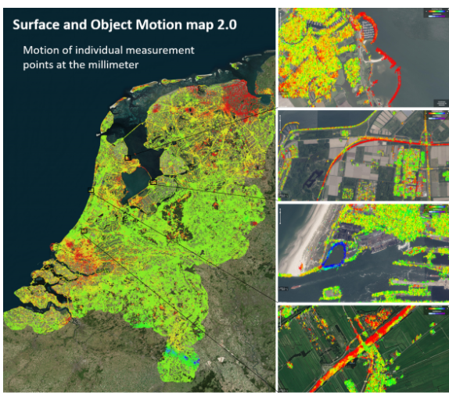
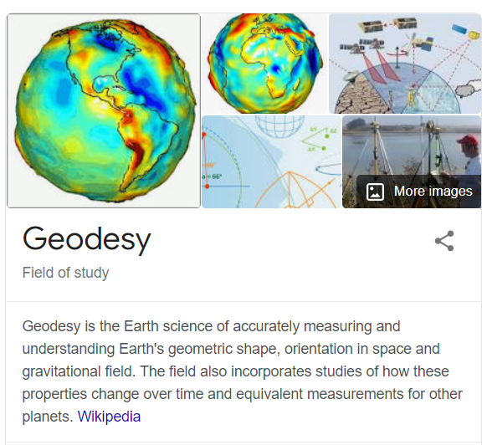



The Dataset
The Map
Geodesy
For the safety of the NL it is therefore of importance to measure and monitor the motion of the land as well as objects on it.
Who?
NL Centre for Geodesy and Geo-Informatics (NCG), in collaboration with universities (TU Delft, UTwente, HU), knowledge centres (KNMI), and geodetic companies (SkyGeo, 06-GPS).
What?
When measuring points move relative to each other, these differences usually represent the deformation of the Earth's surface, or the movement of objects relative to each other.

Slide 3
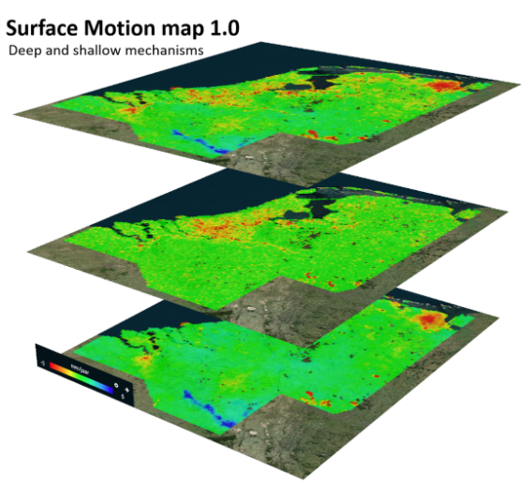
Description
Item | Comments
Website | https://bodemdalingskaart.nl/en-us/
Format | The Map 2.0, the data is presented in six separate files in CSV format. This is a total of about 350 GB (zipped about 100 GB) of data.
Update Freq | The satellites take measurements almost every day over a large part of the Netherlands. On average about four times a week, all over the Netherlands. The map and the dataset itself are recalculated a few times a year, based on all available geodetic measurement data.
Quality | The measurements themselves have a precision of the order of one millimeter. Depending on the location, location-specific noise or anomalies may be added. This is therefore different from place to place. Water surfaces are the worst (too much location-bound noise), and hard infrastructure is best (little location-bound noise). In data processing, the worst observations are automatically removed, but this is a statistical procedure and therefore never perfect
Scientific Reference | The map and the dataset itself are recalculated a few times a year, based on all available geodetic measurement data. We are constantly working on improving the algorithms to better estimate and determine movement.
Open Acess | Yes (need login to receive the map - CC BY-SA 4.0 .). Other licenses for commercial purposes
Resolution | The InSAR geodetic measuring points are irregularly distributed over the area. With the resolution cell size used, one can make an optimal statistical evaluation, because sufficient measurement points are available per cell. Subsidence map 2.0 does show the individual selected measurement points at object level.
Notes:
Example of layers in right just to ilustrate, like pink buildings and Orange forest

Slide 4
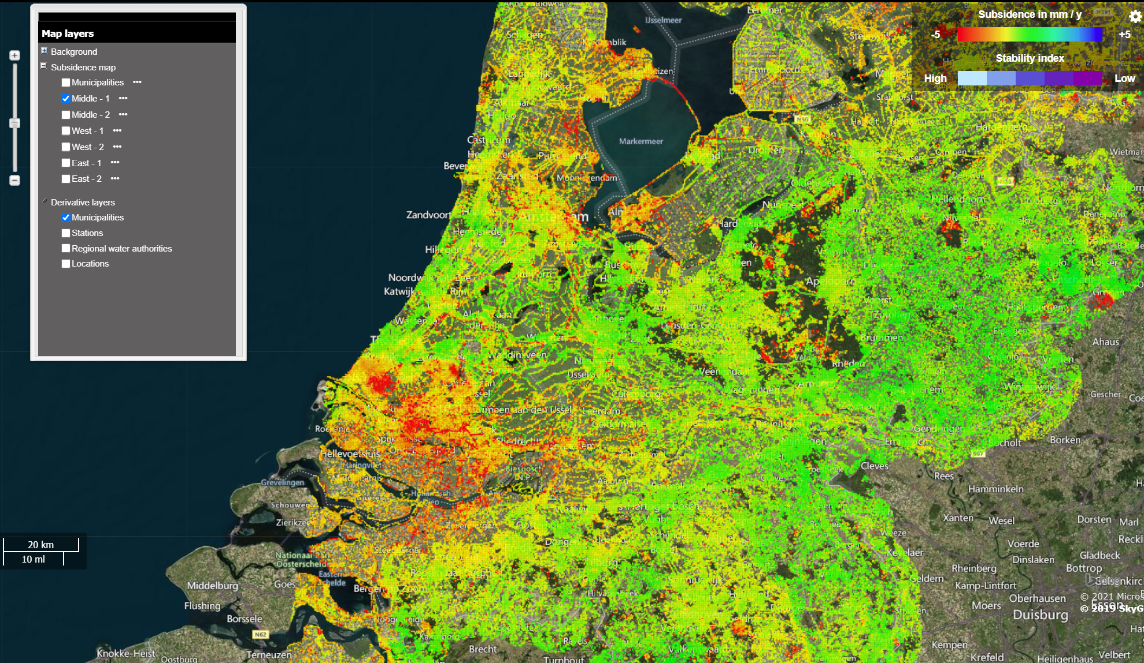
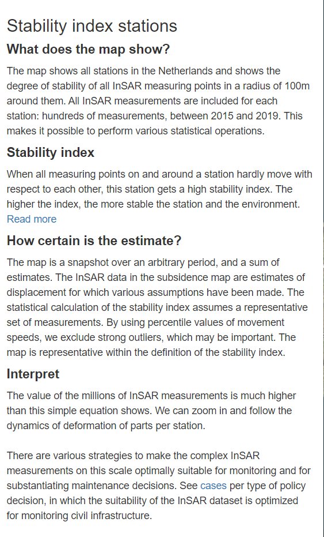

Slide 5
